Slide 1
GitHub, AWS & Initial Setup
Lab – Week 1

Slide 2
Agenda
Tech stack.
Git & GitHub partnership.
Servers and AWS.

Slide 3
Technology
Spring VS Mean stack

Slide 4
Criterion
Jobs
Java and JavaScript
Applications other than web [mobile & frontend]
Complexity
Libraries

Slide 5
Version Control Systems
Git & GitHub

Slide 6

How would you Collaborate?
Discussion

Slide 7
Need for VCS
Collaboration
Storing Versions (Properly)
Restoring Previous Versions
Understanding What Happened (Who did What)
Backup
*References : http://bit.ly/2wMX68r

Slide 8
Right frame of mind
For git

Slide 9
Important Git basics
Snapshots, Not Differences
Git Generally Only Adds Data
The Three States
No BS tutorial : http://rogerdudler.github.io/git-guide/
References : http://bit.ly/2wEapIV

Slide 10
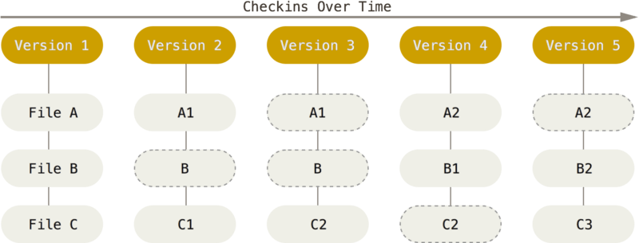
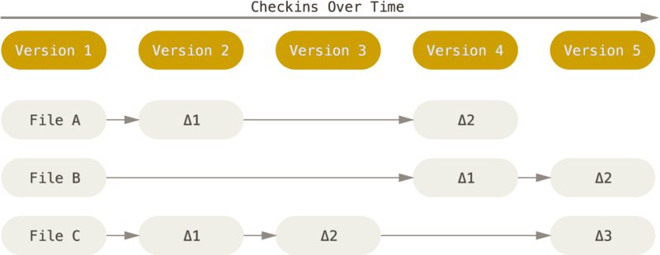
Snapshots not Differences
Git vs Subversion etc
Credits : http://bit.ly/2wEapIV

Slide 11
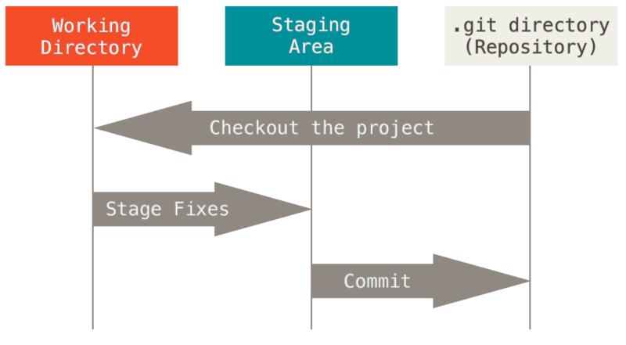
States of code
Modified
Staged
Committed

Slide 12
How to use it in your team

Slide 13

Git Workflow
https://nvie.com/posts/a-successful-git-branching-model/
No One size fits all

Slide 14
Setup
windows : git scm https://git-scm.com/
Linux : apt-get install git [use any other package manager]
OSX : Already installed. Else use brew

Slide 15
GitHub & CSI518
Free private repos for every student, all shared with instructors and graders.

Slide 16
Demo

